Slide 1
WIX1002
Fundamentals of Programming
Chapter 2
Java Fundamental

Slide 2
Contents
Variable
Operator
Type Casting
String
Console Input
Console Output
Comment
Random Number

Slide 3
Variable
A variable is a storage location in the memory that has a type, name and contents.
  A variable must be declared, specifying the variable's name and the type of information that will be held in it.
Identifier is the name of the variable. In Java, identifier may contains letters, digits (0 – 9), and the underscore (_) character.
However, identifier cannot begin with a digit, cannot contain spaces and cannot be reserved words.
A meaningful identifier will made the program easy to understand.
By convention, variable names should start with a lowercase letter

Slide 4
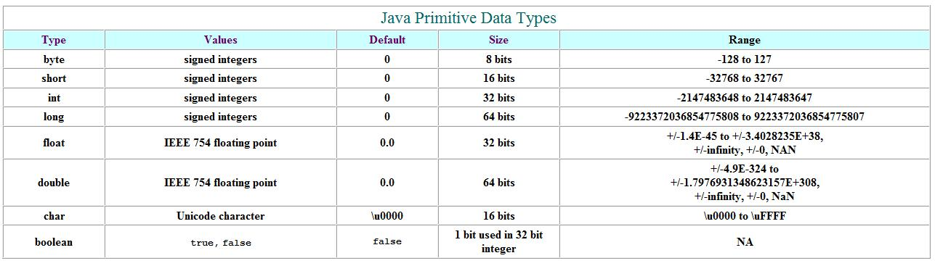
Variable
Java has basic types for characters, integers and floating points number. These basic types are known as primitive types.
Java Unicode character chart
  http://www.ssec.wisc.edu/~tomw/java/unicode.html

Slide 5
Variable
declaration
  int number;
  double first, second;
  boolean status;
initialization
  double speed = 2.6;
  char letter = 'A'; //use single quote for character

Slide 6
Variable
A constant is an identifier that is similar to a variable except that it holds one value for its entire existence
The compiler will issue an error if you try to change a constant variable
Constant is declared using the final keyword.
  final int MIN=0;
  final int MAX=100;

Slide 7
Operator
Operators are special symbols that perform specific operations on one or more operands.
An operand is the part of a computer instruction which specifies what data is to be manipulated or operated on.
Assignment Operator (=)
  It is used to change the value of variable after the variable has been declared.
  temperature = 36.9;
  grade = 'c';
  status = true;

Slide 8
Operator
Arithmetic Operator
  It is used to compute numeric results
  + (addition) - (subtraction) * (multiplication) / (divison) % (modulo or remainder)
  temperature = a + 36.9;
  total = monthlyPayment * 12;
  answer = 20 % 6; // answer is 2

Slide 9
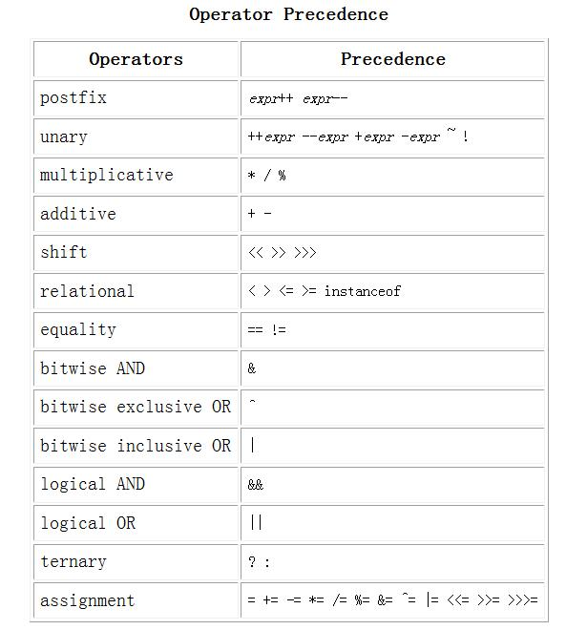
Operator
Java follows precedence rules that determine how the operators are executed in order

Slide 10
Operator
Parentheses Operator ( )
  Controls the order in which the operators execute in the expression. Parentheses override the normal precedence order
Postfix Operator
  number++;
    Use the current value of number. Then increment by 1 for the next statement.
  number--;
    Use the current value of number. Then decrement by 1 for the next statement

Slide 11
Operator
Unary Operator
  ++number;
    Increment number by 1 and then use the value
  --number;
    Decrement number by 1 and then use the value.
Other assignment operator
  number += 5; // -=, *=, /=, %=
  number = number + 5;

Slide 12
Type Casting
Sometimes it is convenient to convert data from one type to another. For example, we may want to treat an integer as a double value during a computation
Type casting takes a value of one type and produces a value of another type.
  int a=8, b=3;
  double answer;
  answer = a / b; // Output is 2
  answer = a / (double) b; // Output is 2.6666

Slide 13
String
A string is a sequence of characters that is treated as a single value.
String class is used to store and process strings of characters.
Declaration and initialization
  String fullname;
  String topic = "Object-oriented Programming";
Concatenation
  + operator is used to connecting two strings.
  String firstName, lastName, fullname;
  fullname = firstname + lastname;

Slide 14
Console Input
Scanner Class
  A simple text scanner which can used to get input for primitive types and strings.
  To load Scanner Class into java program
    import java.util.Scanner;
    Scanner keyboard = new Scanner(System.in);
    int num;
    System.out.println("Please enter a number");
    num = keyboard.nextInt();
    System.out.println(“The number is " + num);

Slide 15
Console Input
.nextInt()
  Reads one int from the keyboard
.nextLong()
  Reads one long int from the keyboard
.nextDouble()
  Reads one double from the keyboard
.next()
  Reads one word into String class from the keyboard
.nextLine()
  Reads an entire line into String class from the keyboard

Slide 16
Console Output
System.out is known as the standard output object
System.out.println display a line of text in the command window. When it completes its tasks it automatically positions the output cursor to the beginning of the next line.
System.out.print display a line of text in the command window. However, it does not position the output cursor at the beginning of the next line in command window.
System.out.printf display output in a specific format

Slide 17
Console Output
Code | Output | Examples
d | decimal integer | %d %6d
f | fixed-point floating point | %f %6.2f
e | E-notation floating point | %e %4.2e
g | general floating point | %g %4.2g
s | string | %s %20s
c | character | %c %5c
- | left alignment | %-5d
System.out.printf(“%6.2f”, 22/7.0)
  Display 6 spaces with 2 decimal places as in _ _3.14
System.out.printf(“PI%-6.2fValue”, 22/7.0)
  Display PI3.14_ _Value
‘.’ also count as 1 space

Slide 18

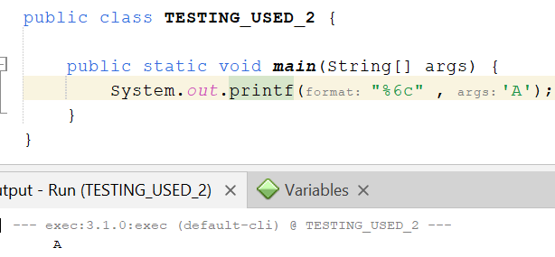


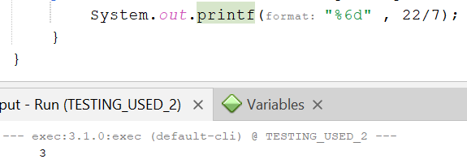
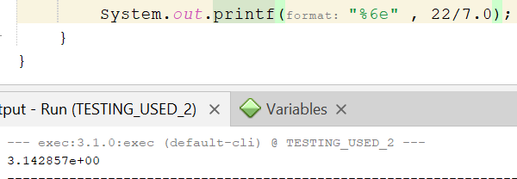
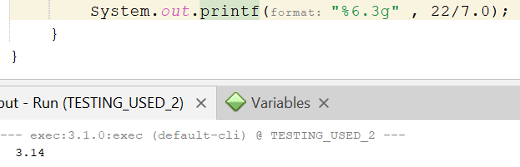


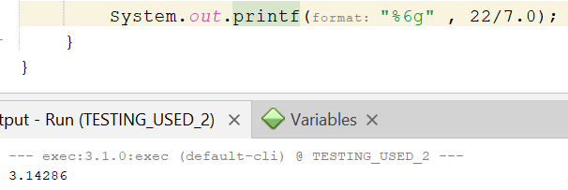

Slide 19
Console Output
You can use some of the special characters in the standard output object
Special Character
  \n is the newline character. It cause the screen’s output cursor to move to the beginning of the next line
  \t is the horizontal tab character
  \\ display a backslash character
  \" display a double quote character

Slide 20
Comment
Comment is used to help other programmers to understand the program
Comments are not executed when the application start.
There are three types of comment in Java
Single line comment
  // A Single Line Comment
Multiple lines comment
  /*
  A multiple
  line comments
  */

Slide 21
Comment
Documentation comment describe the functionalities of each Java class and methods.
  /**
  This method display a line of text on the screen
  */
How to write a standard Java Documentation Comment
  https://www.oracle.com/technical-resources/articles/java/javadoc-tool.html
To run javadoc on a package
  javadoc -d documentationDirectory PackageName

Slide 22
Random Number
Random number is very useful in game and simulation
The Random class of Java implements a random number generator
  import java.util.Random;
    Random g = new Random();
    int num;
    num = g.nextInt(); //any random value of integer
    int MAX = 100;
    num = g.nextInt(MAX); // random value from 0 to 99

Slide 23


